Slide 1
PRINCIPAL’S REPORT

Slide 2
TOPICS
Current Attendance
Leveling
Budget Update
School Strategic Plan
CIP Goals
GMAS Results
Strategic Plan

Slide 3
CURRENT ATTENDANCE

Slide 4
ENROLLMENT
Projected Enrollment | 336
Current Enrollment | 282
Difference | -54
Notes:
Principals: Based on your enrollment, please give your GO Team the information on how you plan to account for any budget changes due to leveling.
Change in enrollment was a decrease from 424 students to 391. A difference of 33 students.

Slide 5
BUDGET UPDATE

Slide 6
LEVELING
Leveling is the process the District uses to adjust school budget allocations to match student enrollment.
Leveling | $-280,422
General Fund Carryover | $9,277
School Reserve Funds | $70,391
Net Adjustment: | $55,893
Leveling is the process the District uses to adjust school budget allocations to match student enrollment.
Budget Impact | (Principal: input change in allocation for your school and discuss how you are going to address the change in allocation)

Slide 7
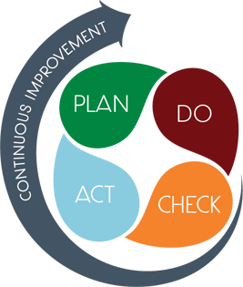
STRATEGIC PLAN SMART GOALS
Overview
Priorities
Key Aspects
SMART GOALS

Slide 8
Smart Goals
By May 2023, students in grades 3-5 will increase ELA proficiency on GMAS from 14% to 19%.

Slide 9
Smart Goals
By May 2023, students in grades 3-5 will increase Math proficiency on GMAS from 14% to 19%.

Slide 10
Smart Goals
By May 2023, K-5 attendance rate will improve from 89% to 95%.

Slide 11
GEORGIA MILESTONES ASSESSMENT RESULTS

Slide 12
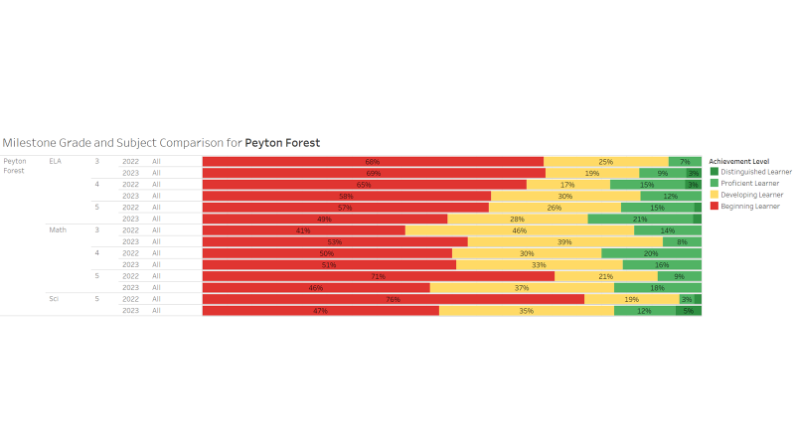
GMAS RESULTS

Slide 13
Peyton Forest
SMART Goals
By May 2023, students in grades 3-5 will increase ELA proficiency on GMAS from 14% to 19%.
By May 2023, students in grades 3-5 will increase Math proficiency on GMAS from 14% to 19%.
May 2023, K-5 attendance rate will improve from 89% to 95%.
APS Strategic Priorities
& Initiatives
School Strategic Priorities
School Strategies
Fostering Academic
Excellence for All
Data
Curriculum & Instruction
Signature Program
1.Use data to drive instruction and academic decisions.
2. .Increase academic achievement in core subject areas.
3. Engage in monthly IB trainings for staff
1.Conduct personalized monthly student data meetings.
2. Increase small group instruction.
3. Implement daily phonemic awareness and phonics instruction (FUNdations & Rollins Center).
4. Integrate writing across the curriculum
5. Use MAP data to guide student intervention groups.
6. Conduct 90 minutes of IB PL monthly.
Building a Culture of
Student Support
Whole Child & Intervention Personalized Learning
4. Increase student attendance & engagement
5.Implement a Whole-Child system of supports that integrates social-emotional learning, behavior, wellness, and comprehensive academic intervention plans
1.Provide monthly student attendance initiatives
2. Provide monthly parent newsletters focused on attendance
3. Attendance team will contact by phone and in writing the parents of students with chronic absenteeism.
4. Provide small group mental health interventions led by Counselor and through Hazel Health
5. Provide daily SEL lessons
6. Implement District Personalized Learning Pathway
Equipping & Empowering
Leaders & Staff
Strategic Staff Support
Equitable Resource Allocation
Build teacher capacity to support the core content knowledge emotional/behavioral needs of students
1.100% of staff will receive IBO Training
2.Increase the number of classroom teachers who are gifted endorsed
3. Implement cognitive development initiatives
4. Provide ongoing PL on SEL & trauma-informed practices
Creating a System of School Support
Strategic Staff Support
Equitable Resource Allocation
7. Sustain family engagement that encourages positive relationships with the school and academic partnerships for children.
1.Maintain and active Go Team each with clear goals and objectives for parent leadership.
2. Conduct monthly family engagement opportunities.
3. Employ effective communication between teachers and parents; Class Dojo and monthly parent letters

Slide 14
QUESTIONS?

